Slide 1

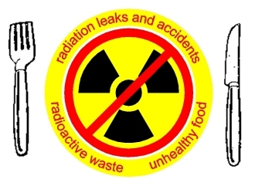
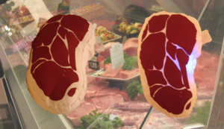
FOOD IRRADIATION PROCESSING

Slide 2
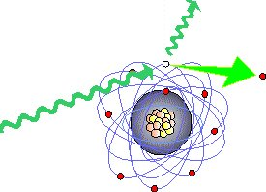
What is Food Irradiation?
Food irradiation is the process of exposing food to ionizing radiation to destroy
microorganisms, bacteria, viruses, or insects that might be present in the food.

Slide 3
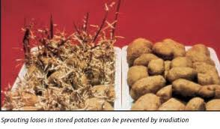
What is Food Irradiation?
Further applications include sprout inhibition, delay of ripening, increase of juice yield, and improvement of re-hydration.

Slide 4
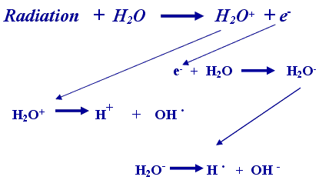
What is Food Irradiation?
Irradiated food
does not become
radioactive,
but in some cases
there may be subtle
chemical changes.

Slide 5
Irradiation
Irradiation is a more general term of the exposure of materials to radiation to achieve a technical goal (in this context "ionizing radiation" is implied).
This process is also used on non-food items, such as medical devices, plastics, tubes for gas pipelines, hoses for floor heating, shrink-foils for food packaging, automobile parts, wires and cables (isolation), tires, and even gemstones.

Slide 6
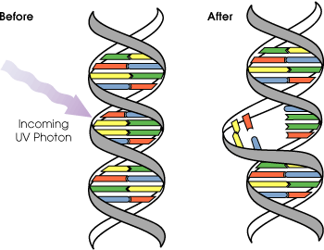
Food Irradiation Process
Food irradiation acts by damaging the target organism's DNA beyond its ability to repair.
Microorganisms can no longer proliferate and continue their malignant or pathogenic activities.

Slide 7
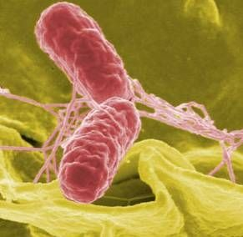
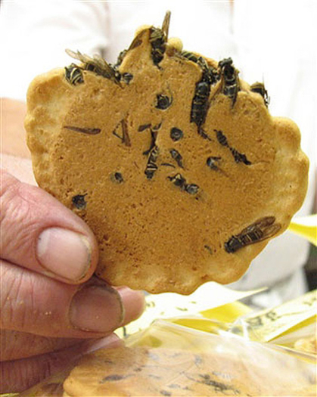
Food Irradiation Process
Food irradiation prevents the following:
  Spoilage-causing microorganism infections
  Insect survival within the food products
  The natural ripening process that plants undergo

Slide 8
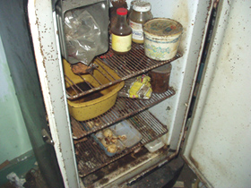

Preventable Losses
1/4 of the world's food production is lost after harvesting
Losses occur where food is grown, during distribution, storage, processing, marketing, and in the home
Losses are especially important in developing countries where transportation and storage systems are not modern, humidity and temperatures are high, and the need for food is the greatest

Slide 9
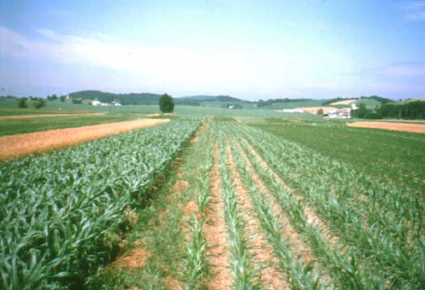
Preventable Losses
Easiest way to increase availability of food is to reduce losses
i.e. it is more cost effective to increase supply by 10 to 20% by reducing losses than it is to improve yield of crops by a few percent

Slide 10
In 1975 the 7th special session of the UN general assembly, adopted a resolution stating:
  “Further reduction of post harvest food losses in developing countries should be undertaken as a matter of priority with a view to reaching at least 50% reduction by 1985”

Slide 11

Government Involvement
The United States Department of Agriculture (USDA) has approved the use of low-level irradiation as an alternative treatment to pesticides for fruits and vegetables that are considered hosts to a number of insect pests, including fruit flies and seed weevils.

Slide 12

Government Involvement
Food and Drug Administration (FDA) has cleared among a number of other applications the treatment of hamburger patties to eliminate the residual risk of a contamination by a virulent E. coli.

Slide 13


Government Involvement
The United Nations Food and Agricultural Organization (FAO) has passed a motion to commit member states to implement irradiation technology for their national phytosanitary programs.
The General assembly of the International Atomic Energy Agency (IAEA) has urged wider use of the irradiation technology.

Slide 14
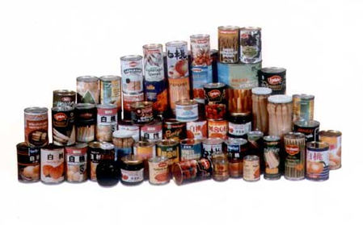
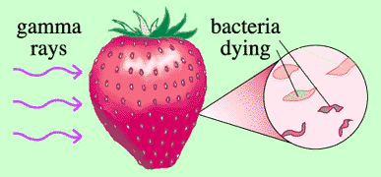

NEED FOR NEW TECHNOLOGY
Despite methods of food preservation such as drying, canning, freezing and fermentation, huge losses still occur
Food irradiation is a physical means of food treatment comparable to processing food by heating or freezing it
The process involves food either prepackaged or in bulk form subjected to γ-rays, x-rays or electrons

Slide 15
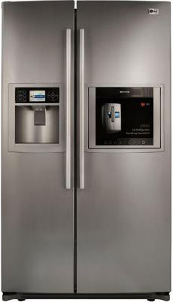
The most common and approved source for γ-rays in food processing are ⁶⁰Co and ¹³⁷Cs with no inducement of radioactivity
Food processing by irradiation is not a ‘miracle’ technique capable of solving all problems
It can solve specific problems of food losses and compliment other established technologies such as refrigeration

Slide 16
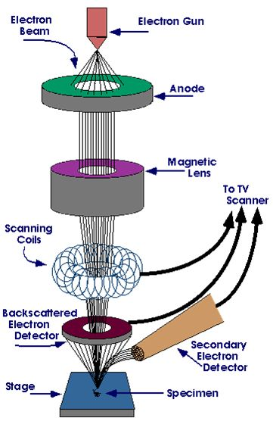
Electron Irradiation
Electron irradiation uses electrons accelerated in an electric field to a velocity close to the speed of light.
Electrons impinge on a target like tungsten, to produce bremsstrahlung radiation.

Slide 17
Gamma Irradiation
Gamma radiation is radiation of photons in the gamma part of the electromagnetic spectrum.
The radiation is obtained through the use of radioisotopes, generally cobalt-60 or
cesium-137.
Food irradiation using cobalt-60 is the preferred method by most processors, because the deeper penetration enables administering treatment to entire industrial pallets or totes, reducing the need for material handling.

Slide 18
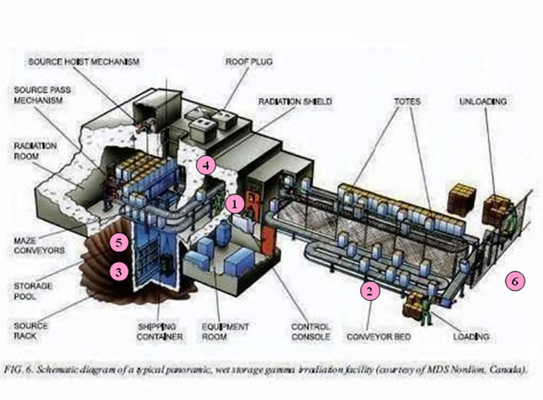

Slide 19
X-Ray Irradiation
Similar to gamma radiation, X-rays are photon radiation of a wide energy spectrum and an alternative to isotope based irradiation systems.
X-rays are generated by colliding accelerated electrons with a dense material (target) such as tantalum or tungsten in a process known as bremsstrahlung-conversion.
X-ray irradiators are scalable and have deep penetration comparable to Co-60, with the added benefit that the electronic source stops radiating when switched off.

Slide 20
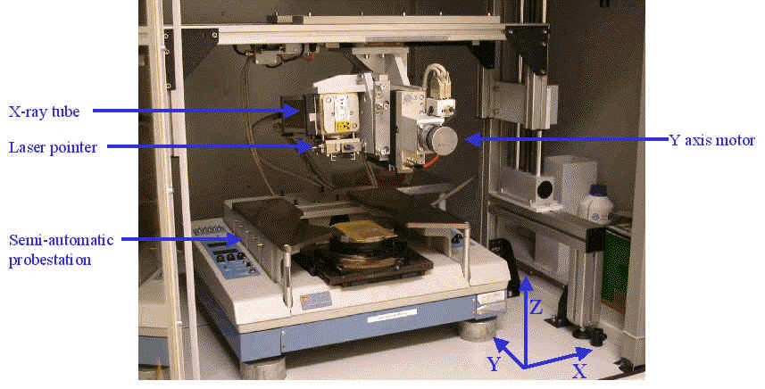

Slide 21
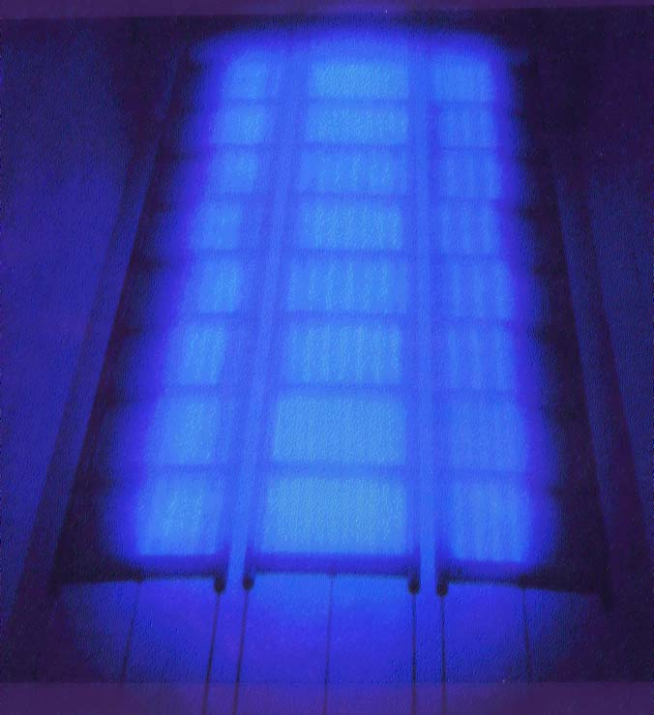
⁶⁰Co Pencils

Slide 22
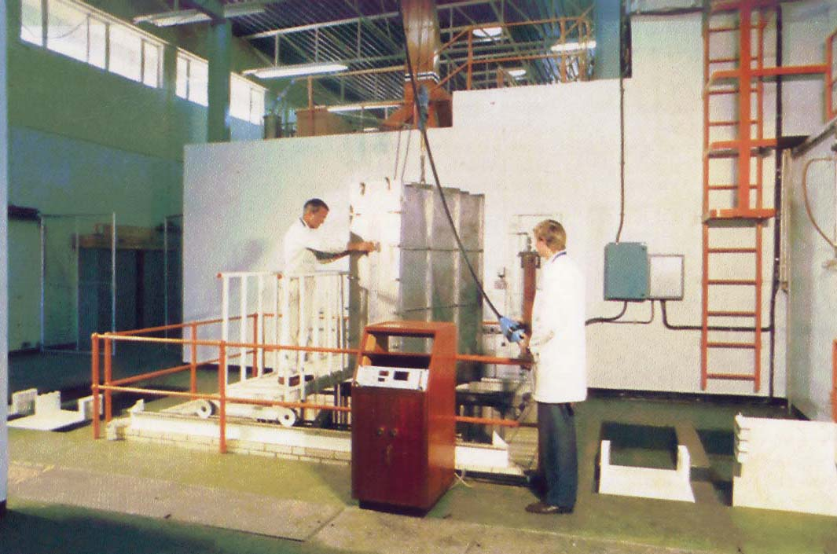
Food Loading

Slide 23
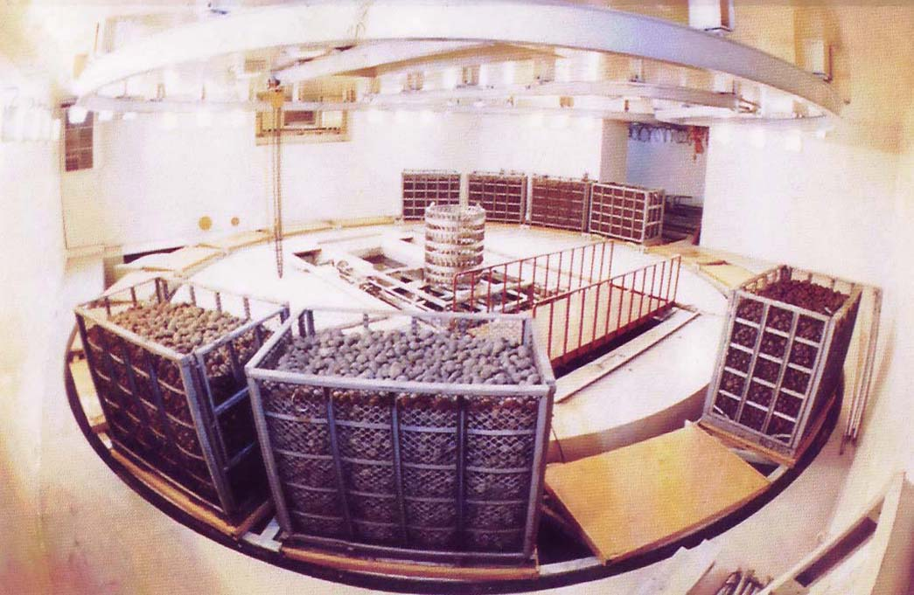
Food Transporter

Slide 24
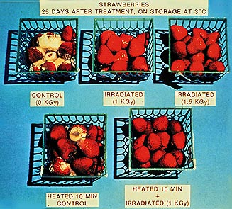
HOW FOOD IRRADIATION PROCESSING WORKS
Biological effects of radiation result from its ability to induce chemical changes in living tissues

Slide 25
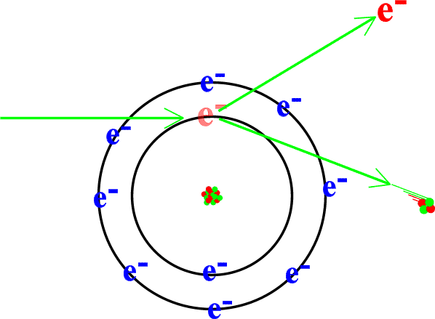
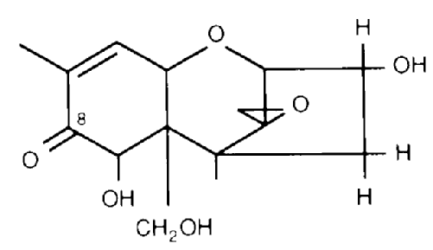
Two Basic Processes Occur When Ionizing Radiation Interacts
Primary process causes formation of ions, excited molecules, or molecular fragments
Secondary process involves interaction of the products of the primary process resulting in the formation of compounds different from those initially present

Slide 26
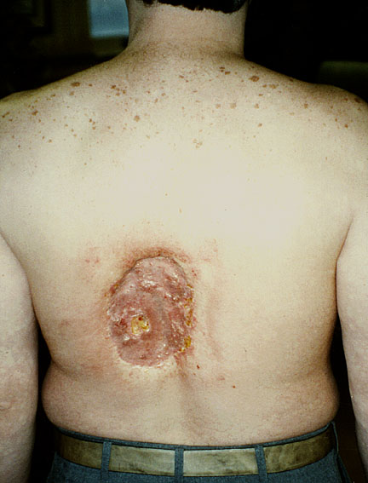
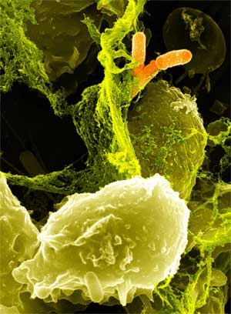
Biological effects of radiation in a living organism are associated with the impairment of metabolic processes responsible for cell division
At low doses, living organisms can recover from radiation injury
Unique advantage of ionizing radiation to kill microorganisms lies in its strong penetrating power

Slide 27
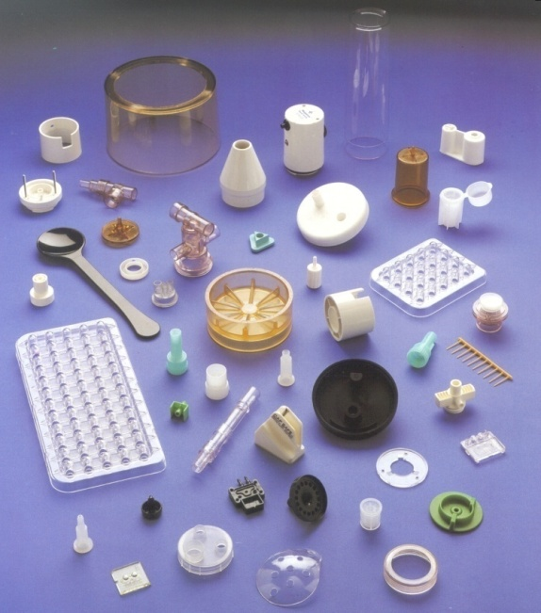
Material to be treated can be exposed to radiation in its final packaging thus avoiding a potential risk of contamination
Ionizing radiation has been successfully used in sterilization of disposable medical and pharmaceutical products

Slide 28
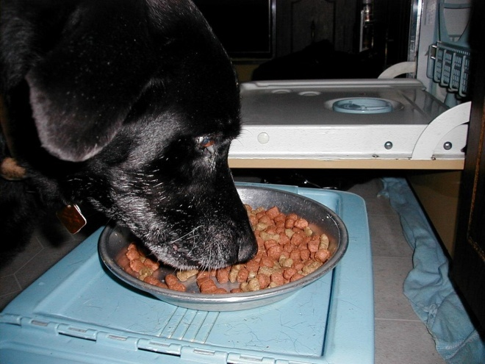
SAFETY OF FOOD IRRADIATION
Numerous studies began in the US in the late 1940's to prove the wholesomeness of food treated by ionization
Sophisticated animal feeding studies of the treated food have been carried out

Slide 29
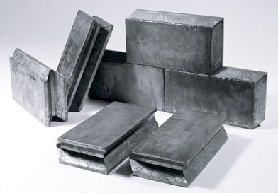
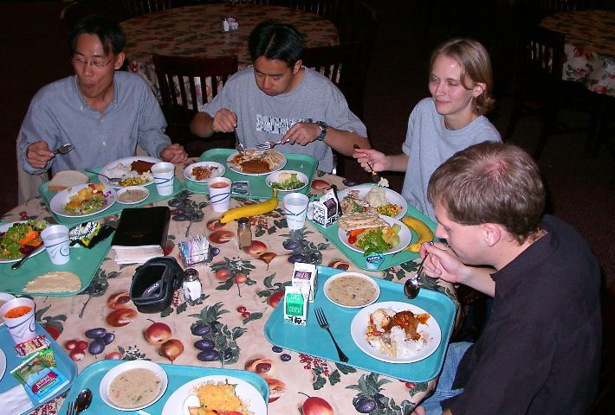
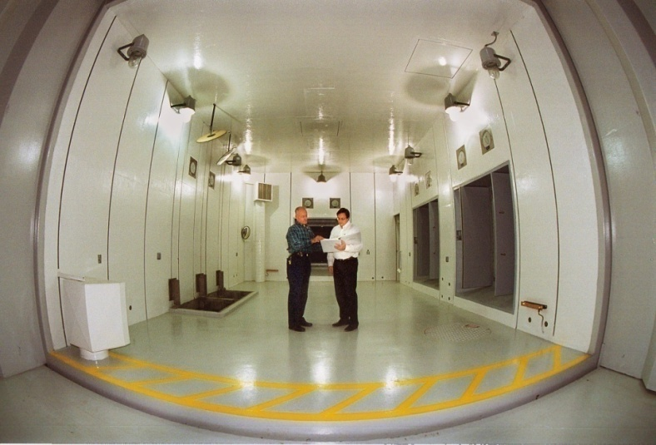
It has not been possible to find any evidence that food treated with ionizing radiation has any adverse effect on the consumer
Special shielding is needed for strong sources in irradiation facilities

Slide 30
PRACTICAL USES OF IRRADIATION
Different doses of ionizing energy can be used for various purposes in food preservation:
  low
  medium
  high

Slide 31
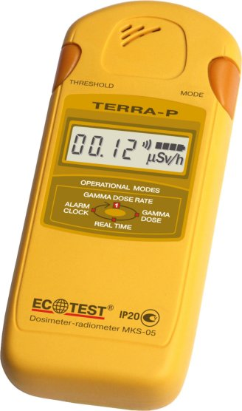
Dosimetry
The measurement of radiation dose is referred to as dosimetry and involves exposing dosimeters jointly with the treated food item.
Dosimeters are small components attached to the irradiated product made of materials that, when exposed to ionizing radiation, change specific, measurable physical attributes to a degree that can be correlated to the dose received.

Slide 32
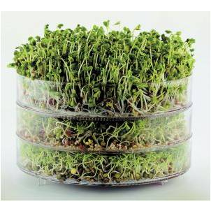

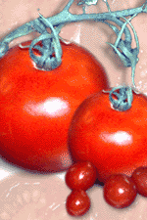
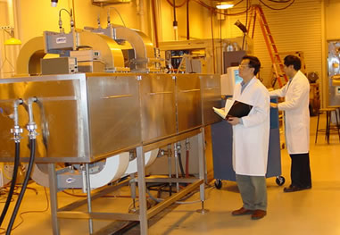
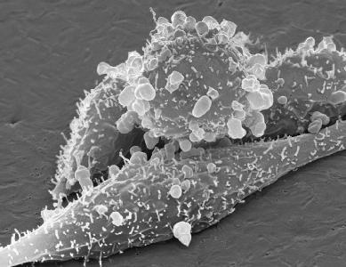
Low Doses (up to 1 kGray)
Inhibition of sprouting
Insect disinfestations – instead of sprays
Delay of ripening
Medium Doses (1-10 kGray)
Extension of food shelf-life
Reduction of microbial load
Improvements in technological properties of food
High Doses (10-50 kGray)
Commercial sterilization
Elimination of viruses

Slide 33
EXAMPLES OF FOOD IRRADIATION
Fish
To control insect infestation of dried fish during storage and marketing (0.5 kGy)
To reduce the microbial load of the packaged fish and fish products (23 kGy)
To eliminate certain pathogenic microorganisms in packaged frozen fish and fish products (35 kGy)

Slide 34
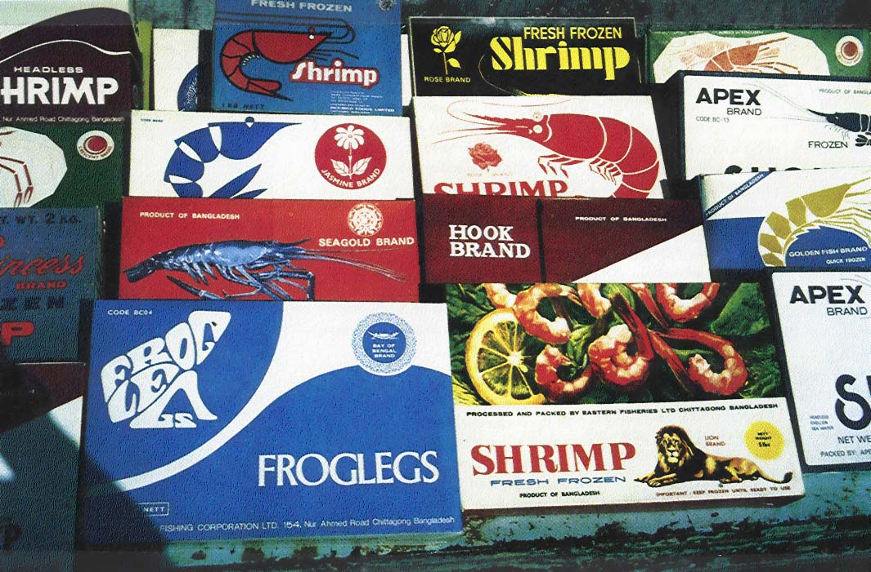

Slide 35
Potatoes and Onions
To inhibit sprouting during storage
(0.0-50.0 kGy)
Food Grains
To control insect infestation during storage (0.5-1.0 kGy)
Cocoa Beans
To control insect infestation during storage (0.5-1.0 kGy)
To reduce the microbial load of fermented beans with or without heat treatment (23 kGy)

Slide 36
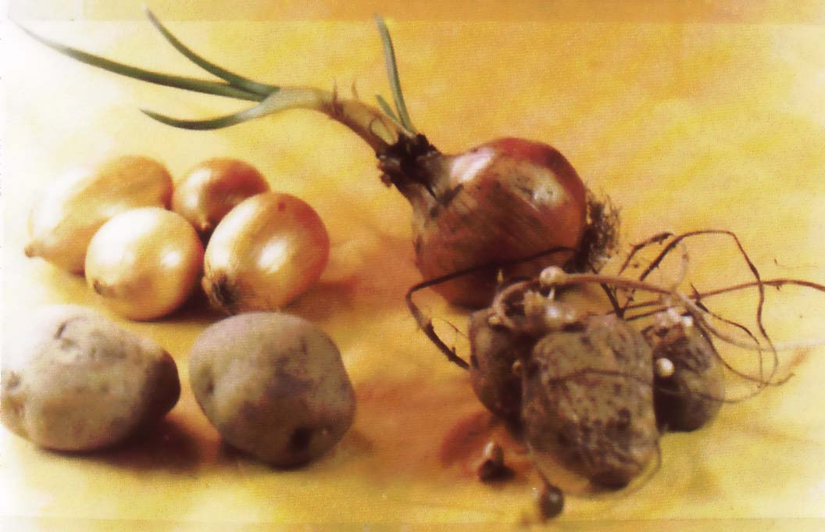
Treated and Untreated

Slide 37
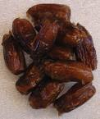
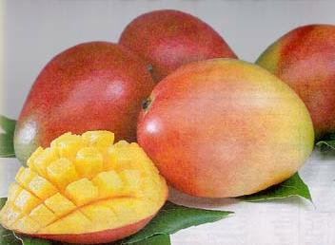
Dates
To control insect infestation in dried dates
(0.5-1.0 kGy)
Mangoes
To control insect infestation
(0.25-0.5 kGy)
To improve quality by delaying ripening
(0.5-1.0 kGy)
To reduce the microbial load through combined irradiation and heat treatment (0.5-1.0 kGy)

Slide 38
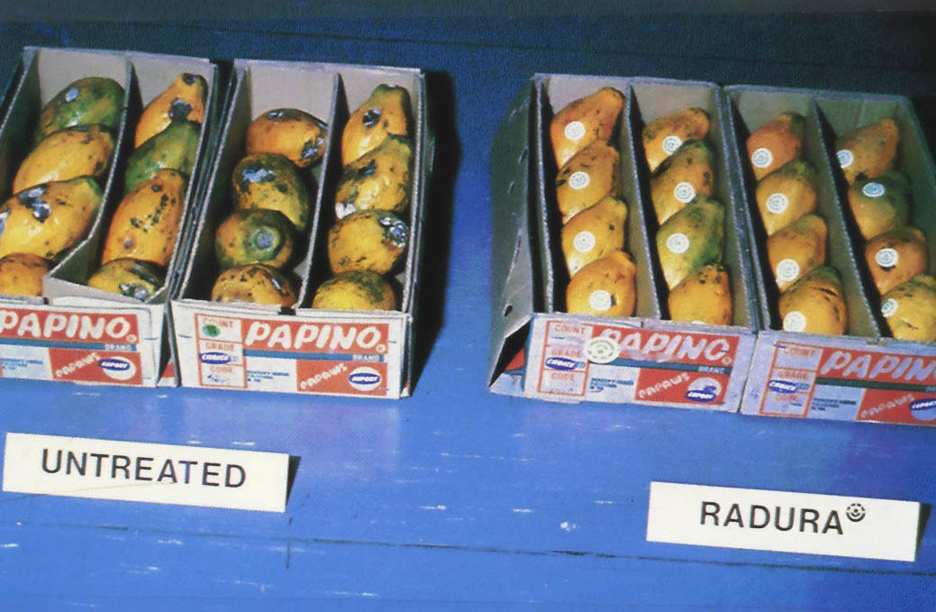
Papaya

Slide 39
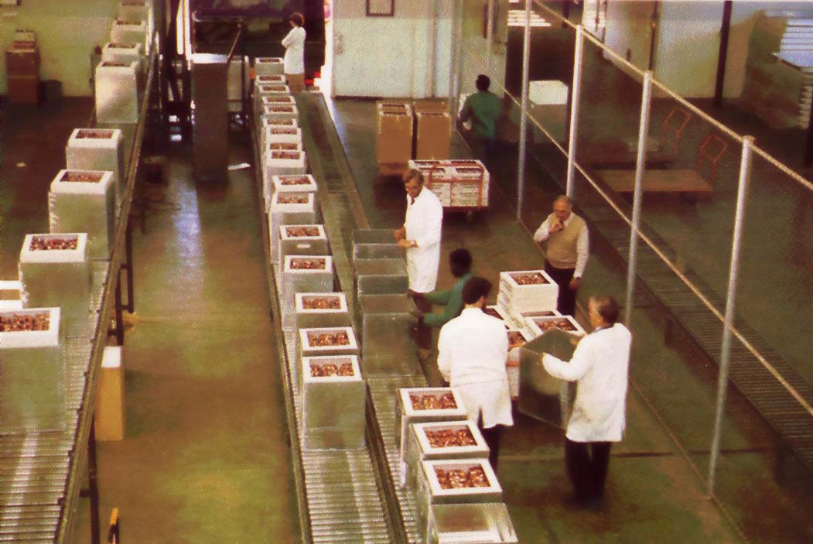
Strawberry Irradiation

Slide 40
Spices and Condiments
To control insect infestation
(0.5 -1.0 kGy)
To reduce the microbial load
(5-10 kGy)
To reduce the number of pathogenic microorganisms (5 kGy)
Meat and Poultry
To extend shelf-life and eliminate pathogenic micro-organisms
(24 kGy)

Slide 41
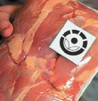
Irradiated Meat

Slide 42
International Use
Food irradiation is currently permitted by over 50 countries, and the volume of food treated is estimated to exceed 500,000 metric tons annually worldwide; however, the extent of clearances varies significantly, from a single item (spices) in the EU to any food in Brazil.

Slide 43
Common Foods of Interest
Food | Countries
Alfalfa | Argentina, Hungary, USA, UK
Carrot | Canada, Chile, Egypt, India, Pakistan, Turkey, USA
Cucumber | Egypt, India, Malaysia, Pakistan
Lettuce | Brazil, Chile, Egypt, Portugal, USA
Melon | Hungary, Pakistan, Portugal, USA
Pineapple | Brazil, India, Malaysia
Watermelon | Brazil, Hungary, Portugal

Slide 44
Some Ethnic Foods of Interest
Food | Country
Cannelloni | Argentina
Chinese Dumpling | China
Prawn Masala | India
Ox-tail Soup | Indonesia
Bulgogi | Korea
Thai Spicy Chicken Basil Rice | Thailand

Slide 45
Current US Market
Several U.S. supermarkets carry irradiated food products ranging from fresh tropical fruit from Hawaii, Florida or Mexico, dehydrated spices, spinach, and ground meat products.
Certain supermarkets prefer not to carry irradiated products for reasons of consumer perception.
Mexico may become the largest exporter of irradiated produce to the US at this point. Varieties will include mango, sweet citrus, manzano Pepper, star fruit, and guava according to the current US / Mexico irradiation work plan.

Slide 46
Current EU market
The European Community has the most restrictive regulations: mandatory by EC-directive, one single item 'spices' is permitted presently in all 27 member states.
Seven members (Belgium, Czech Republic, France, Italy, Netherlands, Poland, United Kingdom) maintain a number of national regulations.
  This has created labeling issues regarding whether the product was irradiated or not.

Slide 47
Consumer Protection
Irradiation has not been widely adopted due to an asserted negative public perception, the concerns expressed by some consumer groups and the reluctance of many food producers.
Consumer organizations, environmentalist groups, and opponents to food irradiation refer to some studies suggesting that a large part of the public questions the safety of irradiated foods, and will not buy foods that have been irradiated.

Slide 48
Consumer Protection
On the other hand, other studies indicate the number of consumers concerned about the safety of irradiated food has decreased in the last 10 years and continues to be less than the number of those concerned about pesticide residues, microbiological contamination, and other food related concerns.
Consumers, given a choice and access to irradiated products, appear ready to buy it in considerably large numbers.

Slide 49

Pros and Cons
Pros
It does not make the food radioactive or less nutritious
It effectively kills harmful bacteria in our food supply
Cons
Public perception of irradiated food
Not applicable to all foods
Need special shielded irradiation facilities using Co-60 ,Cs-137 or electron accelerators

Slide 50
Internet Information and Videos
http://www.cdc.gov/ncidod/dbmd/diseaseinfo/foodirradiation.htm
http://www.wholefoodsmarket.com/products/irradiation.php
http://www.fipa.us/q%26a.pdf
http://www.mnbeef.org/foodirradiation.aspx
http://www.youtube.com/watch?v=S5q1XkG0Rk4

